Slide 1
Cybersecurity for Future Presidents
Lecture 9:
DEBATE #3:
Resolved: The U.S. Election Assistance Commission should promote internet voting for public elections on a model similar to Estonia.

Slide 2
Any Questions?
My office hours:
Wed. afternoon, 12-3pm,
442 RH. Signup sheet circulating
About previous lecture?
About homework? (debate questions)
About reading? (Internet voting articles and video)
Reading for next week: D is for Digital, Chapter 9, The Internet, pp. 135-159
Plus: Stajano CACM paper on scams.
Exercises: Accountability topics and Internet
Next Debate (in 2 weeks): Resolved: Commercially stored genomic data requires no further government regulatory controls.
Debate teams please sign up to see me this week or next week (as teams).

Slide 3
Cybersecurity events from the past week of interest to future (or current) Presidents:
FBI gets into iPhone without Apple’s help; drops court case
7 Iranian civilians indicted in 2011-2013 bank attacks and hack of NY dam controls
3 “Syrian Electronic Army” members charged with criminal hacking over several years, 2011++
diplomacy aspect of both more important than criminal
FTC issues warning letters to app developers using ‘Silverpush’ code
Software monitors microphone to detect inaudible audio beacon codes broadcast in TV programming, to report user’s viewing habits. Potential privacy violation
FTC issues complaint against VW for false “clean diesel” ads in light of emissions testing malware
France fines Google 100,000 Euro for not enforcing RTBF globally (Commission Nationale de l'Informatique et des Libertes (CNIL) )

Slide 4
Today’s 15-minute “extra”
Metcalfe’s “Law”
Telephone network history and Phone Phreaking
In-band vs out-of-band communications
Scams and social engineering

Slide 5
Metcalfe’s “Law”
Bob Metcalfe, co-inventor of Ethernet, argued that there is a “network effect” in the adoption of certain technologies,
The argument is that each person connecting to the network adds more than linearly to the overall value
Examples: telephones or fax machines. A single one is of no use, but the more that are connected, the more useful each one becomes, because there are more other machines to connect with.
The “law” as ultimately stated by George Gilder in 1993:
The value of a telecommunications network is proportional to the square of the number (n) of connected users of the system (=n²).
Like Moore’s law, this is more of an observation than a mathematical principle of some sort, but it’s nevertheless a useful observation
Implication: first network to get started may accrue overwhelming competitive advantage

Slide 6
In-Band signaling in the telephone network
In the circuit-switched telephone network, the signals representing the number to be dialed, as well as internal signals among switching centers flowed over the same lines as the voice signal and were at audio frequencies
Phone phreaks learned that 2600Hz tones entered through the regular voice handset could be used to set up free calls
When the phone company discovered this there was not very much they could do because the in-band signaling was baked deeply into the system, in many components
In the end they developed a new Signaling System 7(SS7), in which the signaling uses different bands (out of band signaling).
Although SS7 also has vulnerabilities, in-band signaling is not among them.

Slide 7
What is “in-band” signaling?
Two kinds of traffic flow in most networks:
Signals: commands that affect the control of the network, e.g. to set up or shut down a connection (signals)
Data: The bits that users want to send to each other (e.g., voice signal for a telephone call)
If both of these kinds of traffic flow over the same infrastructure, they are said to be in the same “band” as in frequency band
In-band signaling may be convenient from an engineering point of view, but can make the network vulnerable to errors or abuse if traffic that is generated by the user can spoof the control signals of the system
This is precisely how “phone phreaks” were able to exploit POTS
Cyber attacks like “SQL injection” are essentially similar: a common input stream accepts not only data but also commands

Slide 8
Social aspects of attacks
Principles behind scams (Stajano and Wilson)
Distraction
Social compliance
Herd
Dishonesty
Kindness
Need/Greed
Time
Early hackers and phone phreaks often exploited “social engineering” rather than technical sophistication
Call the appropriate support staff and have a plausible story (see above principles) as to why they should provide the information/service/etc. that you want
See following page for a less friendly approach

Slide 9
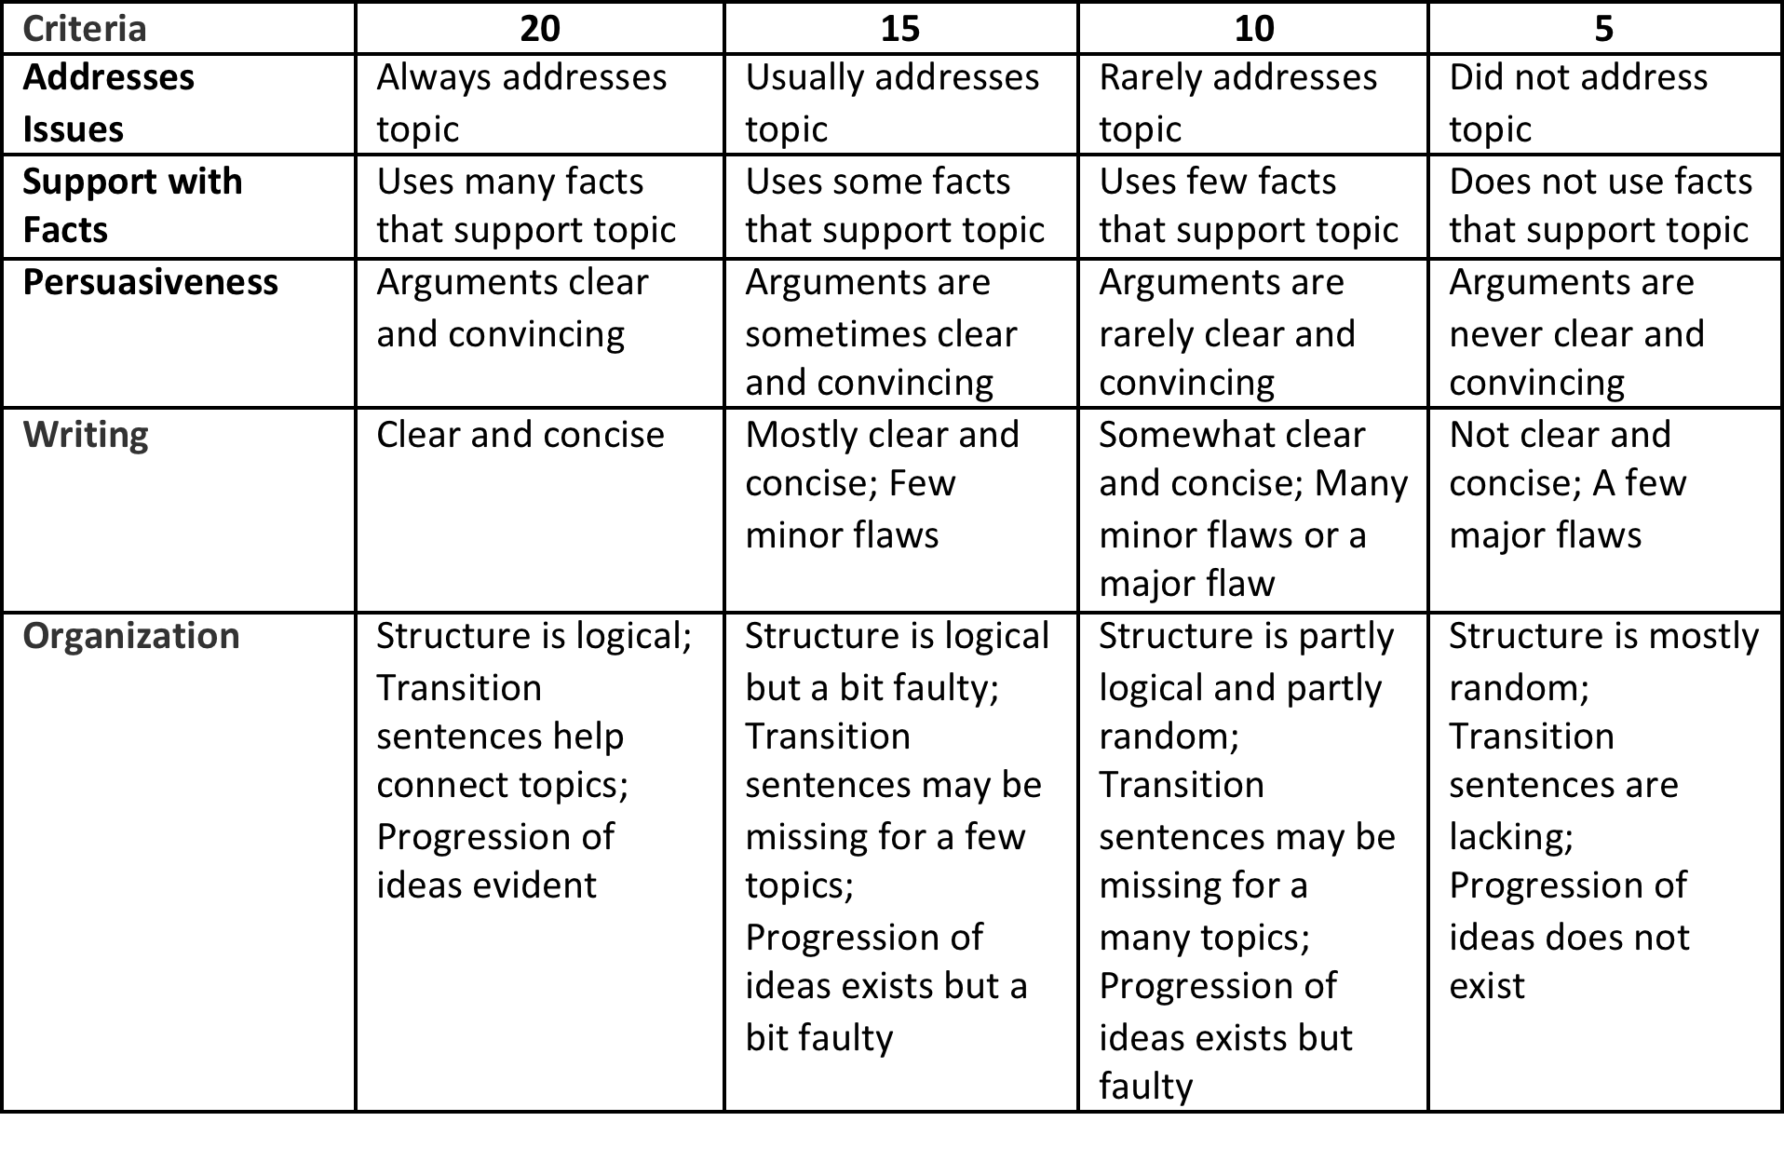
Rubric for Debaters

